Slide 1
Category review: Chips
Dharshan R
September 2024
Retail Analytics
Brand note: If client logo is not required, use alternate title page layout right click slide thumbnail > Layout > Title

Slide 2
Notes:
To view Privacy video explaining how important data privacy is to Quantium, please click here: https://www.youtube.com/watch?v=Zq1QDAkoRzU
or here Q:\Company Reference\Brand & Design\Brand videos\Q Privacy.mp4
At Quantium, we believe that data is the behavioural footprint of humanity and that it has to be treated with the utmost care and responsibility.
Histories, attitudes, indeed lives are stored within it in ways that aren’t always apparent – and that’s what makes its potential so powerful.
To work with it responsibly, sensitively, we set ourselves the highest data privacy protection and governance standards.
We have spent 17 years perfecting privacy-by-design and secure-by-design principles. Central to this is not holding any personally identifiable information about people –
we neither receive it, and put the necessary protections in place to be unable to decipher it.
Every aspect of handling data is safeguarded: from its de-identification, to its encryption – data security is paramount and of the highest grade.
We pride ourselves on gaining the trust of iconic organisations around the world through years of securely working with their data,
and in turn the trust that builds with their stakeholders.

Slide 3
Executive summary
01
Generally, Sales increase significantly in December before Cristmas day on 25th December
Top 3 highest sales: Budget - Older Familes, Mainstream - Young Singles/Couples, Mainstream - Retirees
We found that high spend for (Mainstream - Young Singles/Couples) and (Mainstream - Retirees) are mainly due to the fact that there are more customers in these segment compared to others buyers.
Despite Older families not having highest customers, but they have the highest average units of purchase for each segment, which contributes to their high total sales.
in general for all segments, brand chips kettle has the most frequently purchased brand and burger is the lowest.
most frequent chips size purchased is 175g pack size.
Task 1
02
Task 2
One control store was selected for each trial store and the values of metrics were compared in trial and pre trial period.
The results for trial stores 77 and 88 during the trial period show a significant difference in at least two of the three trial months but this is not the case for trial store 86.

Slide 4
01
Customer Analysis

Slide 5
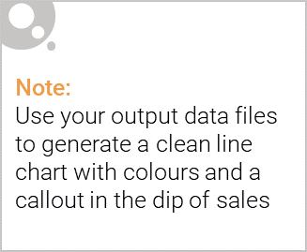
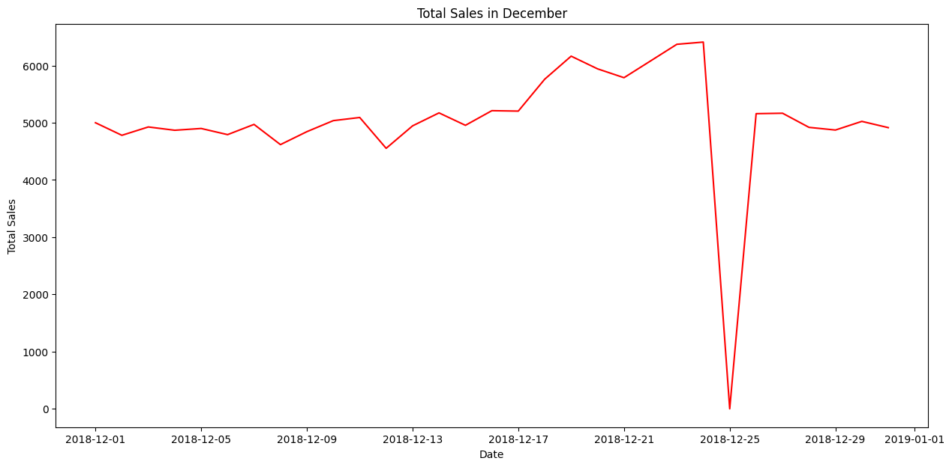
Sales increased steadily closer to Christmas and return again to early December sales level during New Year Eve. There is no transaction on December 25 due to most retail stores are closed during Christmas.
The total number of transactions in the week including Christmas was negatively affected by public holiday store closures

Slide 6
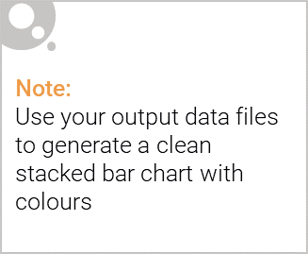
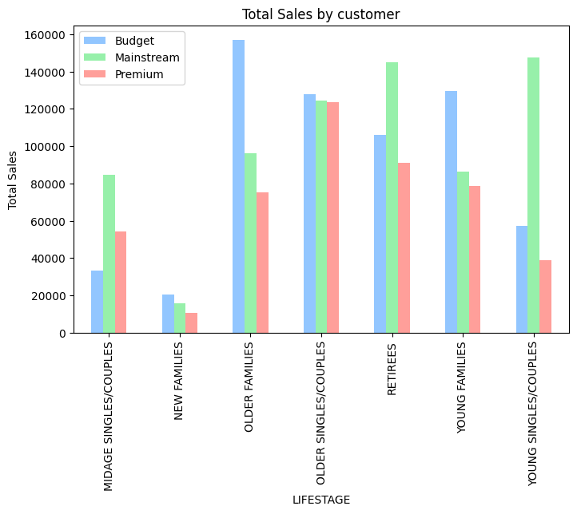
Editable (delete this)
Sales mainly came from Budget - older families, Mainstream – young singles/couples, and Mainstream – retirees.

Slide 7
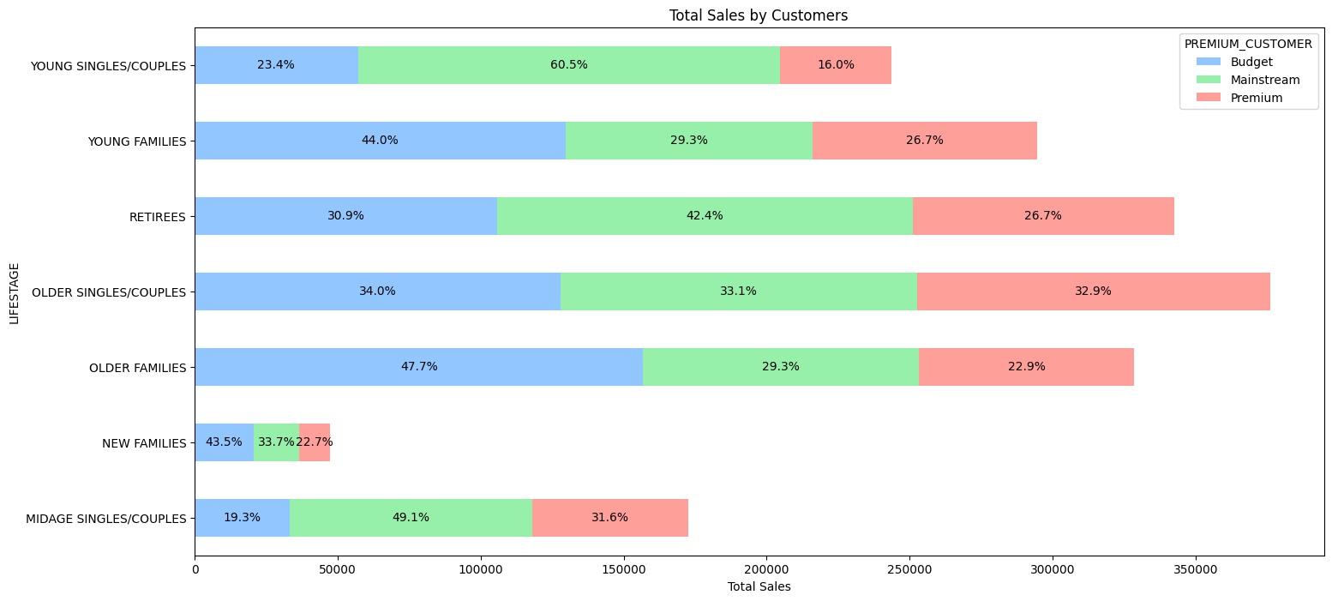
Editable (delete this)
In total, older customers buy more than younger customers

Slide 8
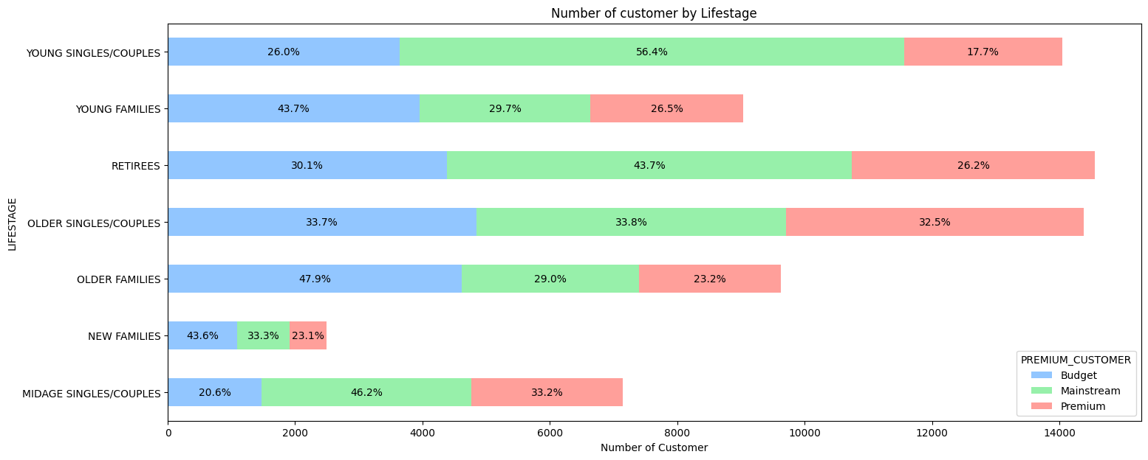
Editable (delete this)
Mainstream Young Singles & Couples make up the largest proportion of Snacking Chips shoppers; Mainstream Retirees also have a significant share

Slide 9

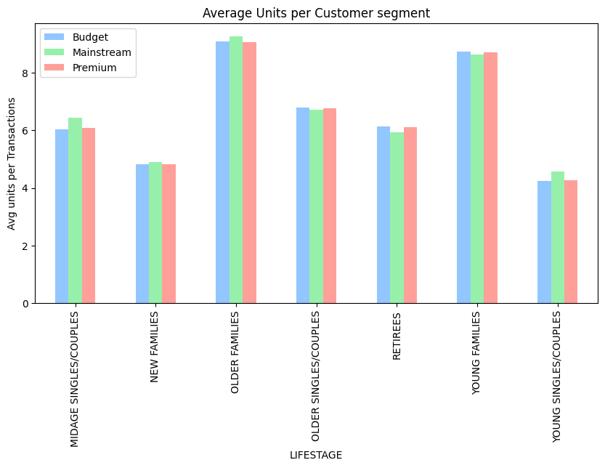
Older and Young Family segment have the highest average units per customer.

Slide 10
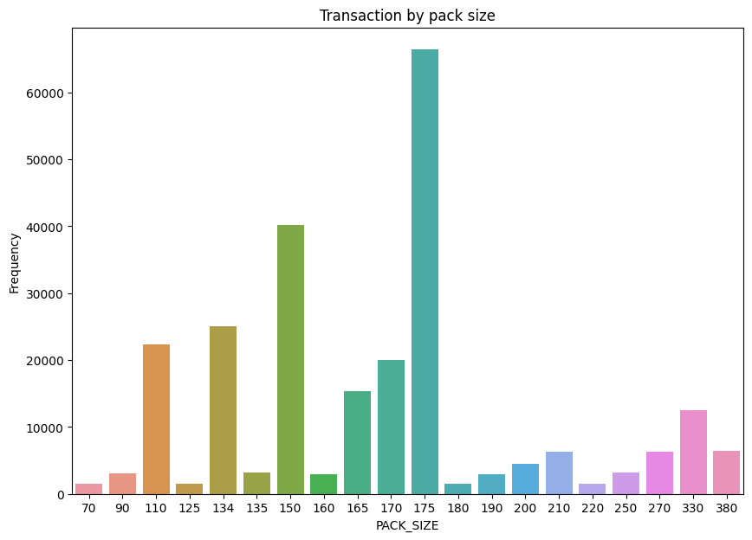
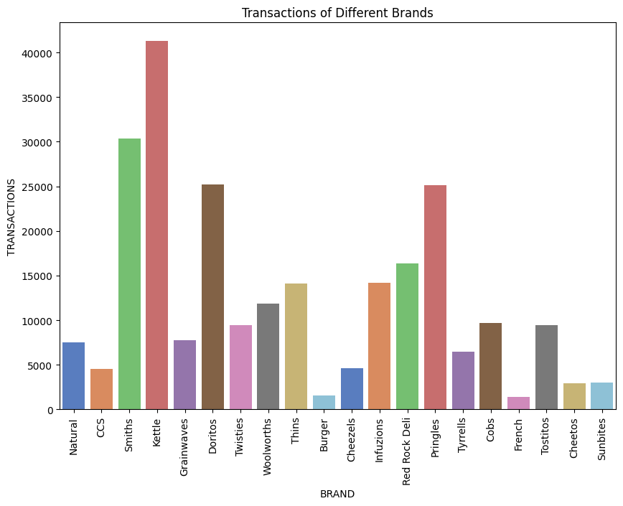
Kettle is the most popular brand followed by Smiths, Doritos, and Pringles. Also, 175-gram packets are the most sold.

Slide 11
02
Trial store performance

Slide 12
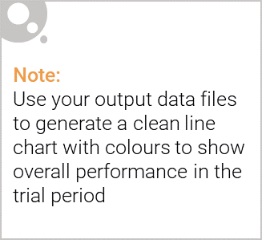
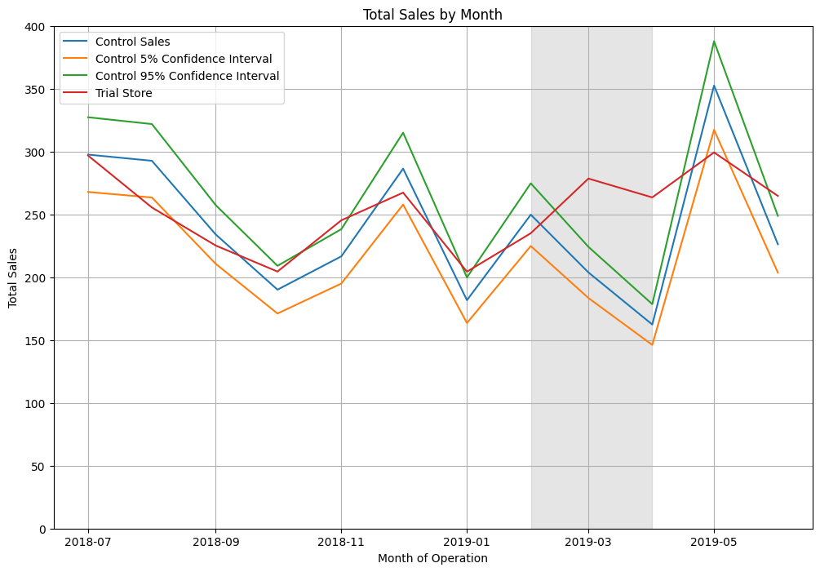
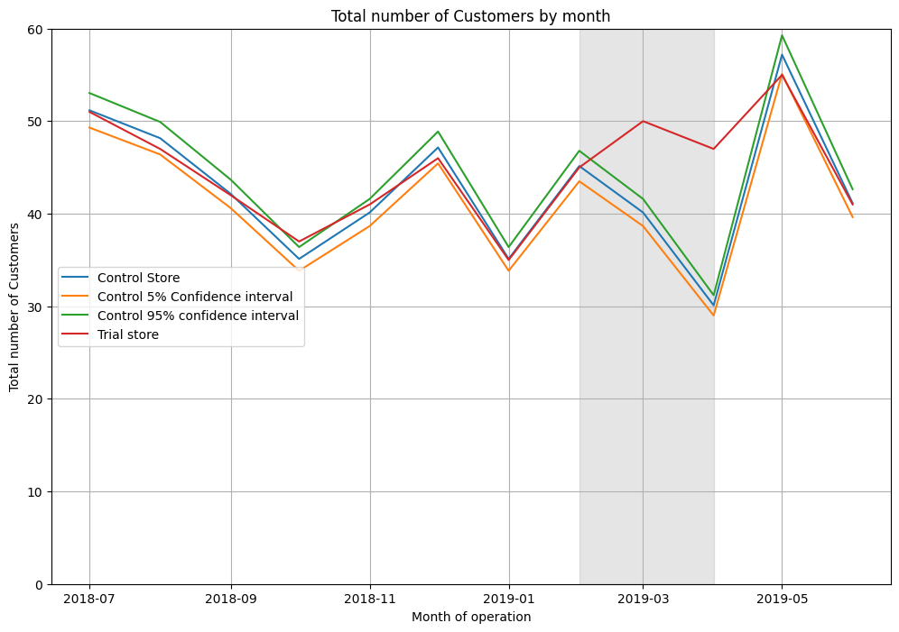
Trial store 77 vs Control store 233
The results show that sales and number of customers the trial in store 77 is significantly different to its control store 233 in the trial period. The trial store performance lies outside the 5% and 95% confidence intervals in the two of the 3 trial months

Slide 13
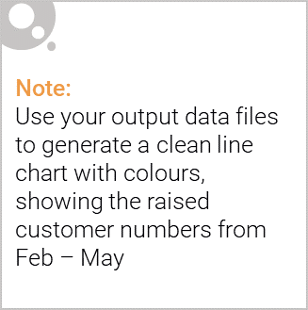
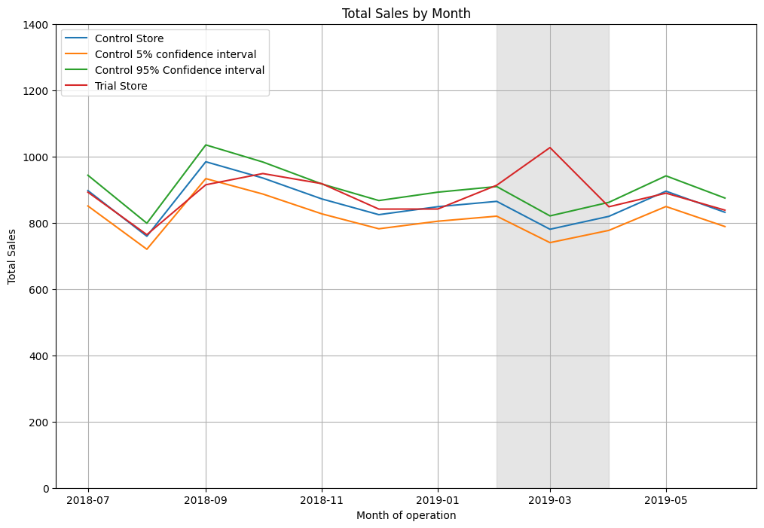
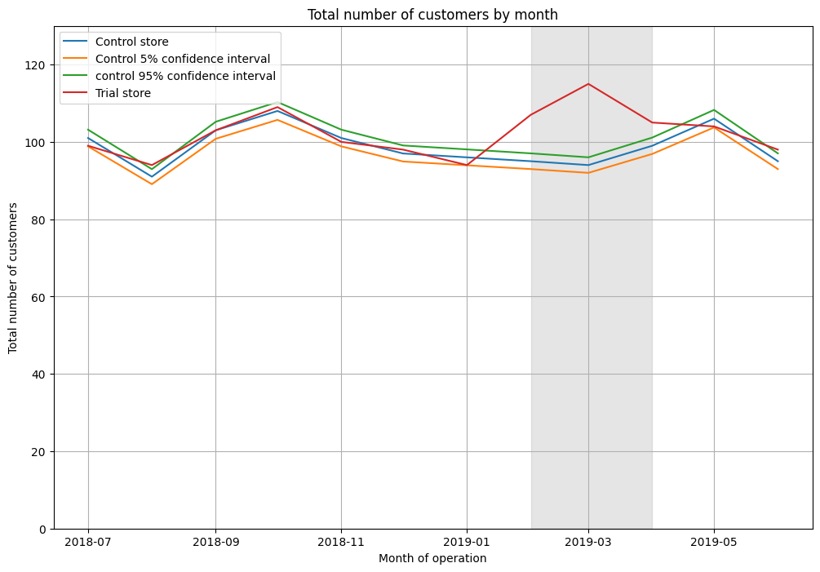
Trial store 86 vs Control store 155
Customers quantity for trial store 86 during the trial period show a significant difference in at least two of the three trial months.

Slide 14
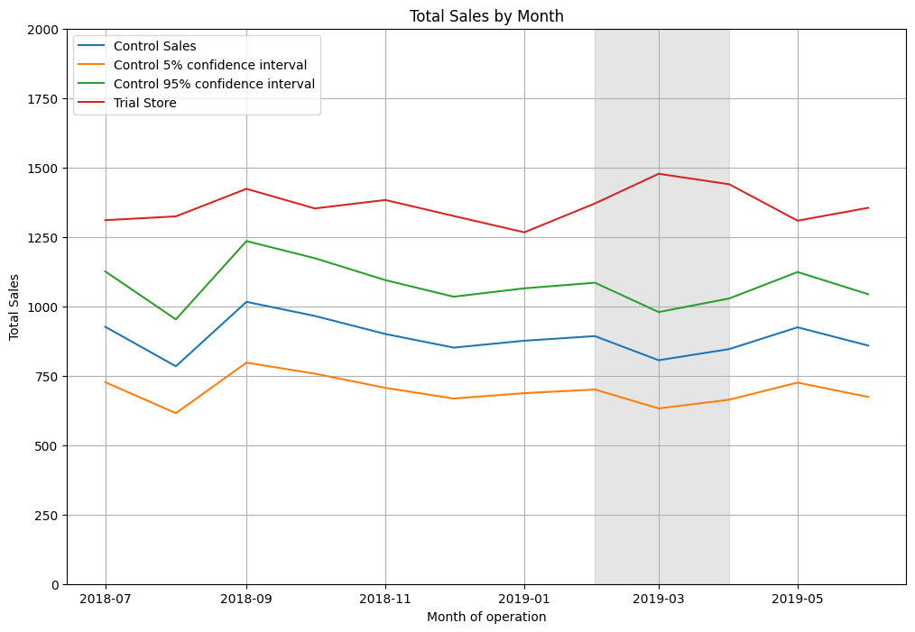
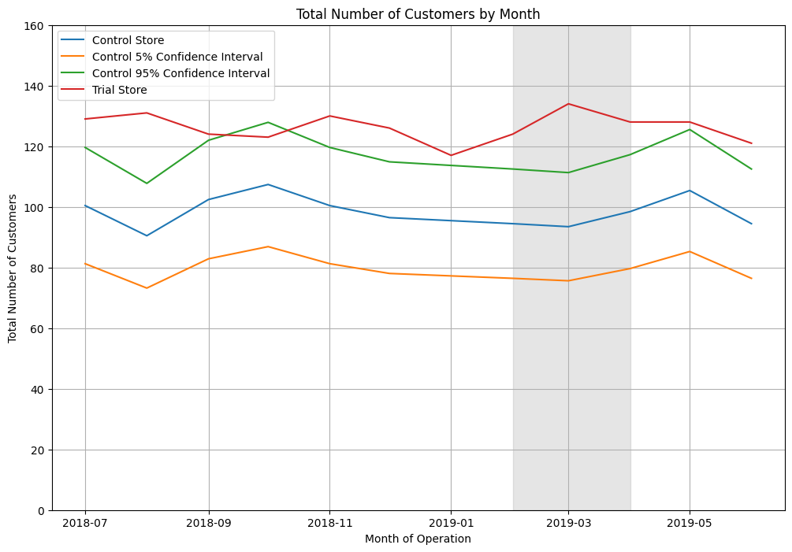
Trial store 88 vs Control store 237
The results show that sales and number of customers the trial in store 88 is significantly different to its control store 237 in the trial period. The trial store performance lies outside the 5% and 95% confidence intervals in the two of the 3 trial months.

Slide 15
Recommendation :
Transaction increase before Christmas on December. So, it is a good opportunity to increase total sales or promotion at this moment and also stocks should be high in December before the Christmas.
Chips brand Kettle, Smiths, Doritos, and Pringles should be kept in stocks as they are the most sold
Mainstream young singles/couples, retirees are the account for a great share of chips sale so they need much attention
Despite Older Families not having the highest population, they have the highest frequency of purchase, which contributes to their high total sales.so, We can give promotions that encourage them to buy more quantity of chips per purchase. and increase the average unit purchase price per customer
Control stores 233, 155, 237 for trial stores 77, 86, and 88 respectively would be a good choice.

